Slide 1
Filling Missing values

Slide 2
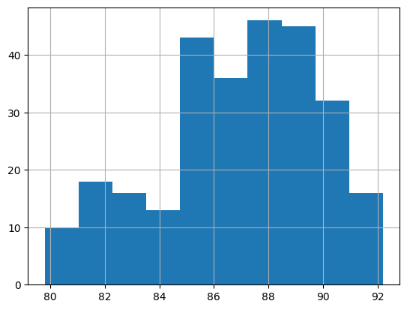
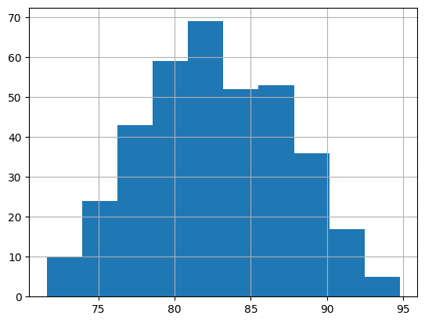
Humidity without missing values
1993
1997

Slide 3
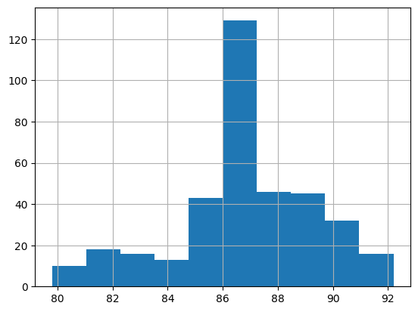
Humidity with missing values filled with the mean of each year
1993
1997

Slide 4
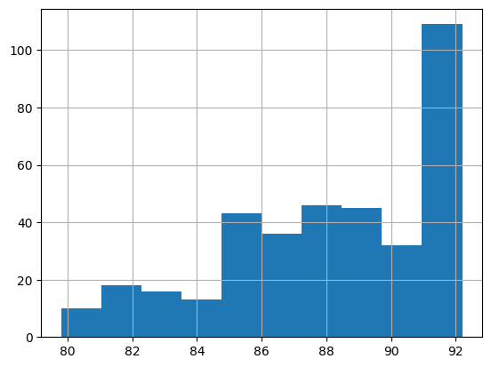
Humidity with missing values filled with forward fill
1993
1997

Slide 5
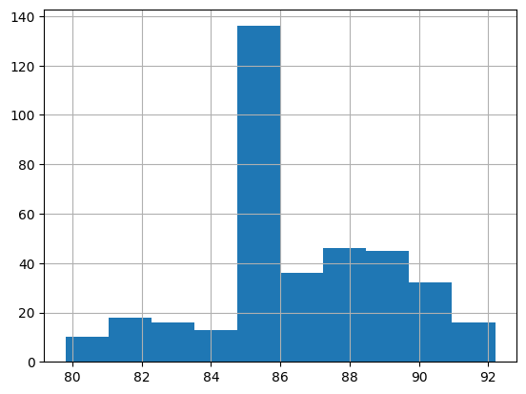
Humidity with missing values filled with backward fill
1993
1997

Slide 6
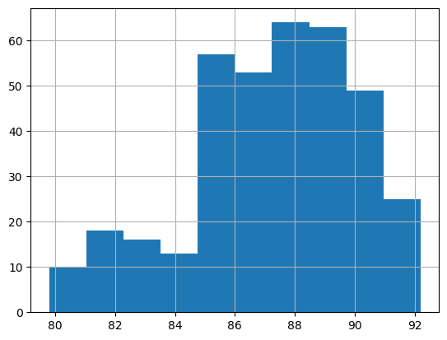
Humidity with missing values filled with interpolate
1993
1997

Slide 7
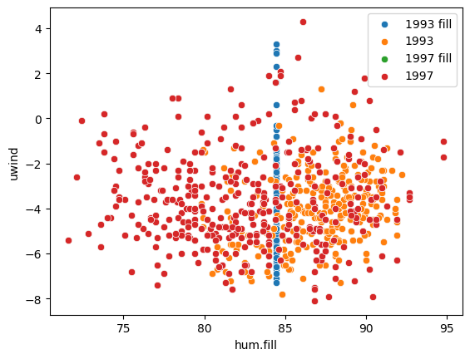
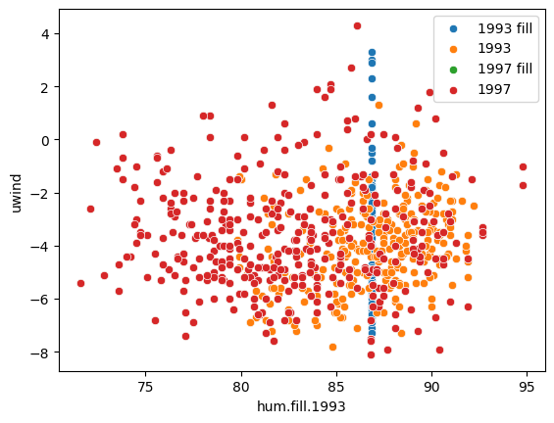
Uwind vs humidity filled with mean
General
Per year

Slide 8
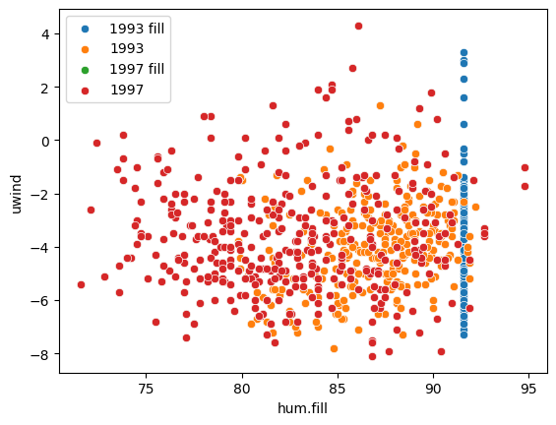

Uwind vs humidity filled with forward fill
General
Per year

Slide 9
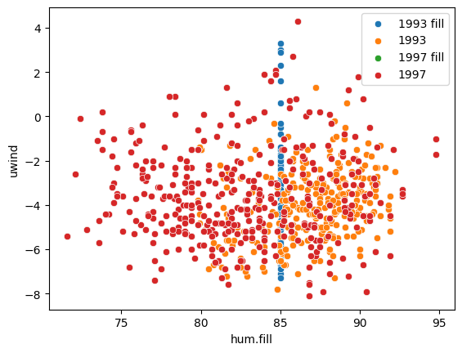

Uwind vs humidity filled with backward fill
General
Per year

Slide 10
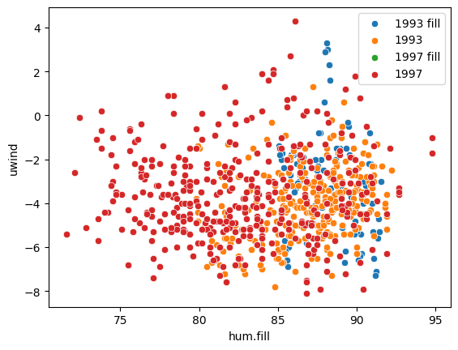
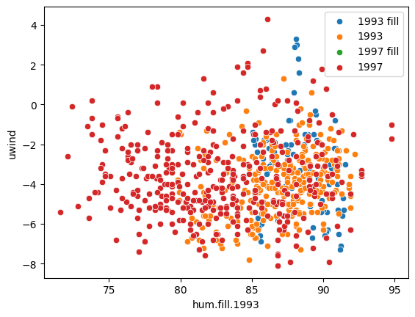
Uwind vs humidity filled with interpolate
General
Per year

Slide 11
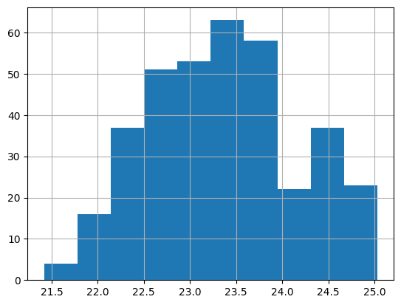
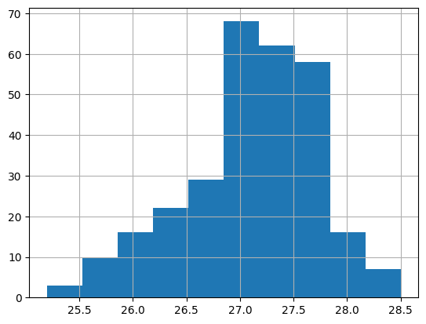
Air.temp without missing values
1993
1997

Slide 12
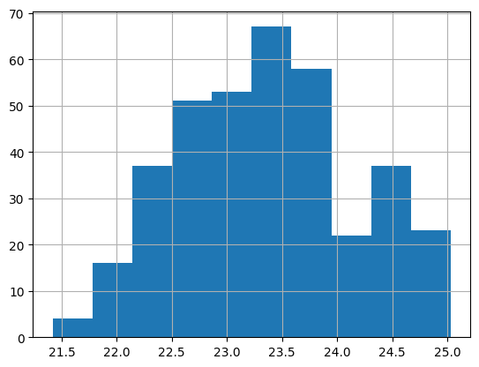
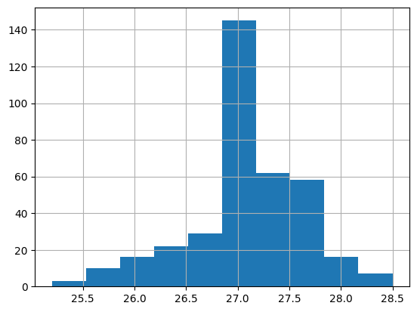
Air.temp without missing values filled with the mean of each year
1993
1997

Slide 13
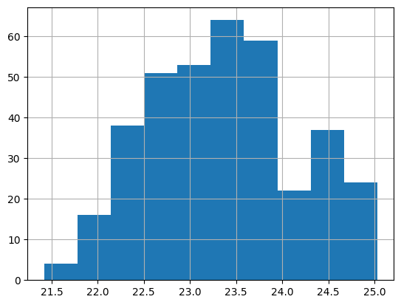
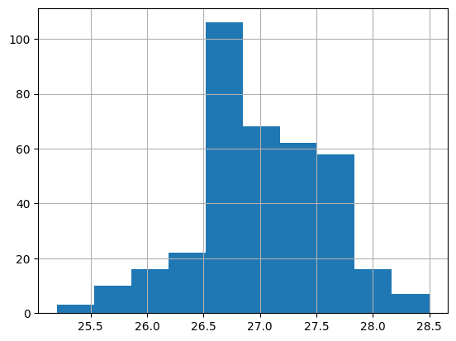
Air.temp without missing values filled with forward fill
1993
1997

Slide 14
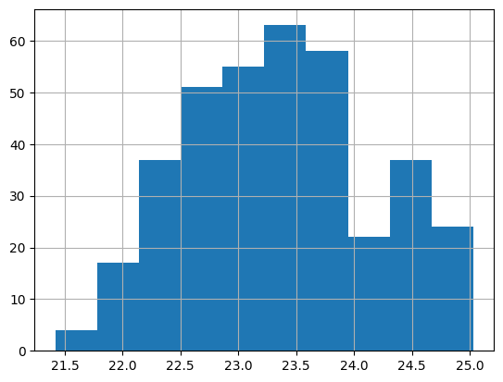
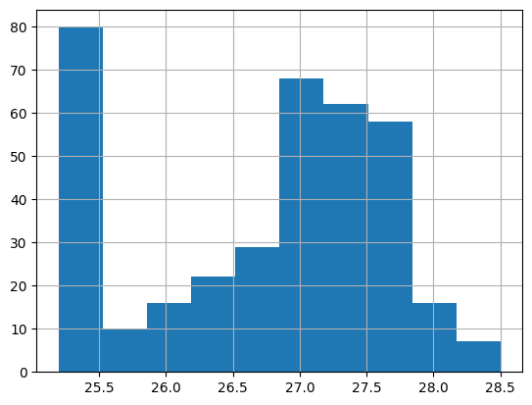
Air.temp without missing values filled with backward fill
1993
1997

Slide 15

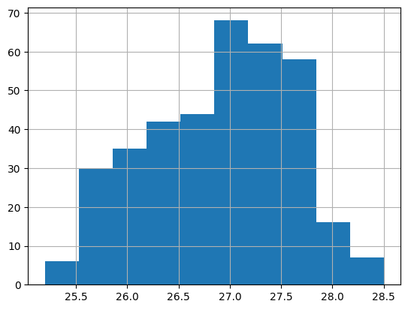
Air.temp without missing values filled with interpolate
1993
1997

Slide 16
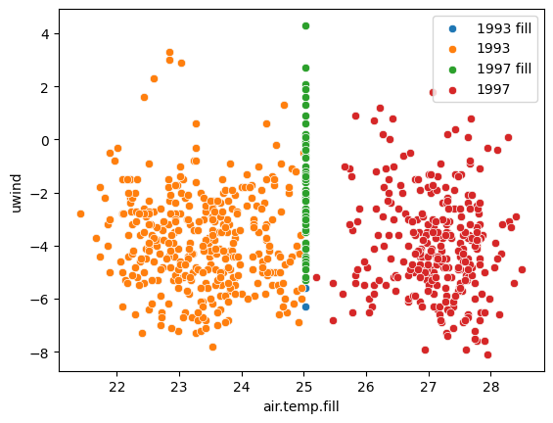
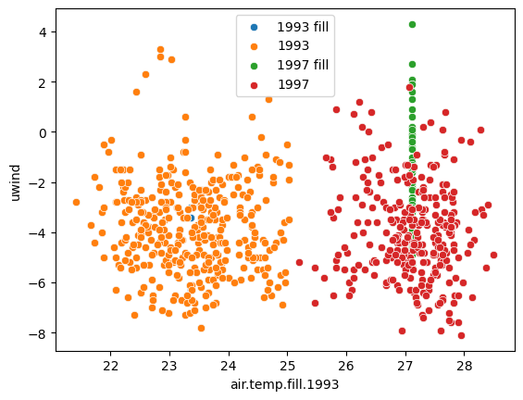
Uwind vs air.temp filled with mean
General
Per year

Slide 17
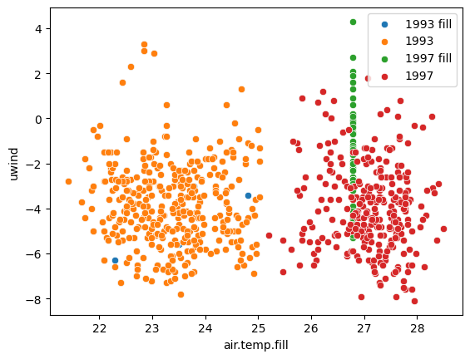

Uwind vs air.temp filled with forward fill
General
Per year

Slide 18
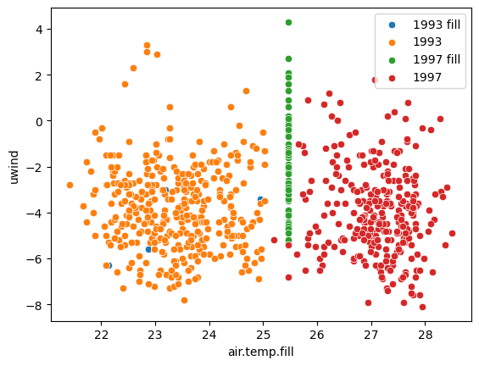

Uwind vs air.temp filled with backward fill
General
Per year

Slide 19
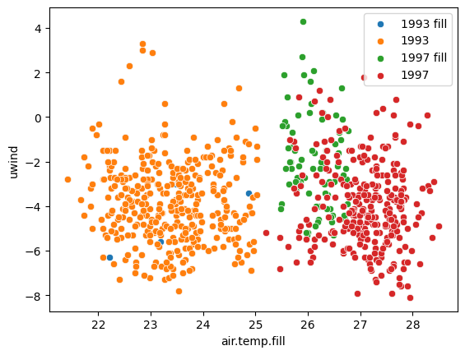

Uwind vs air.temp filled with interpolate
General
Per year

